Slide 1
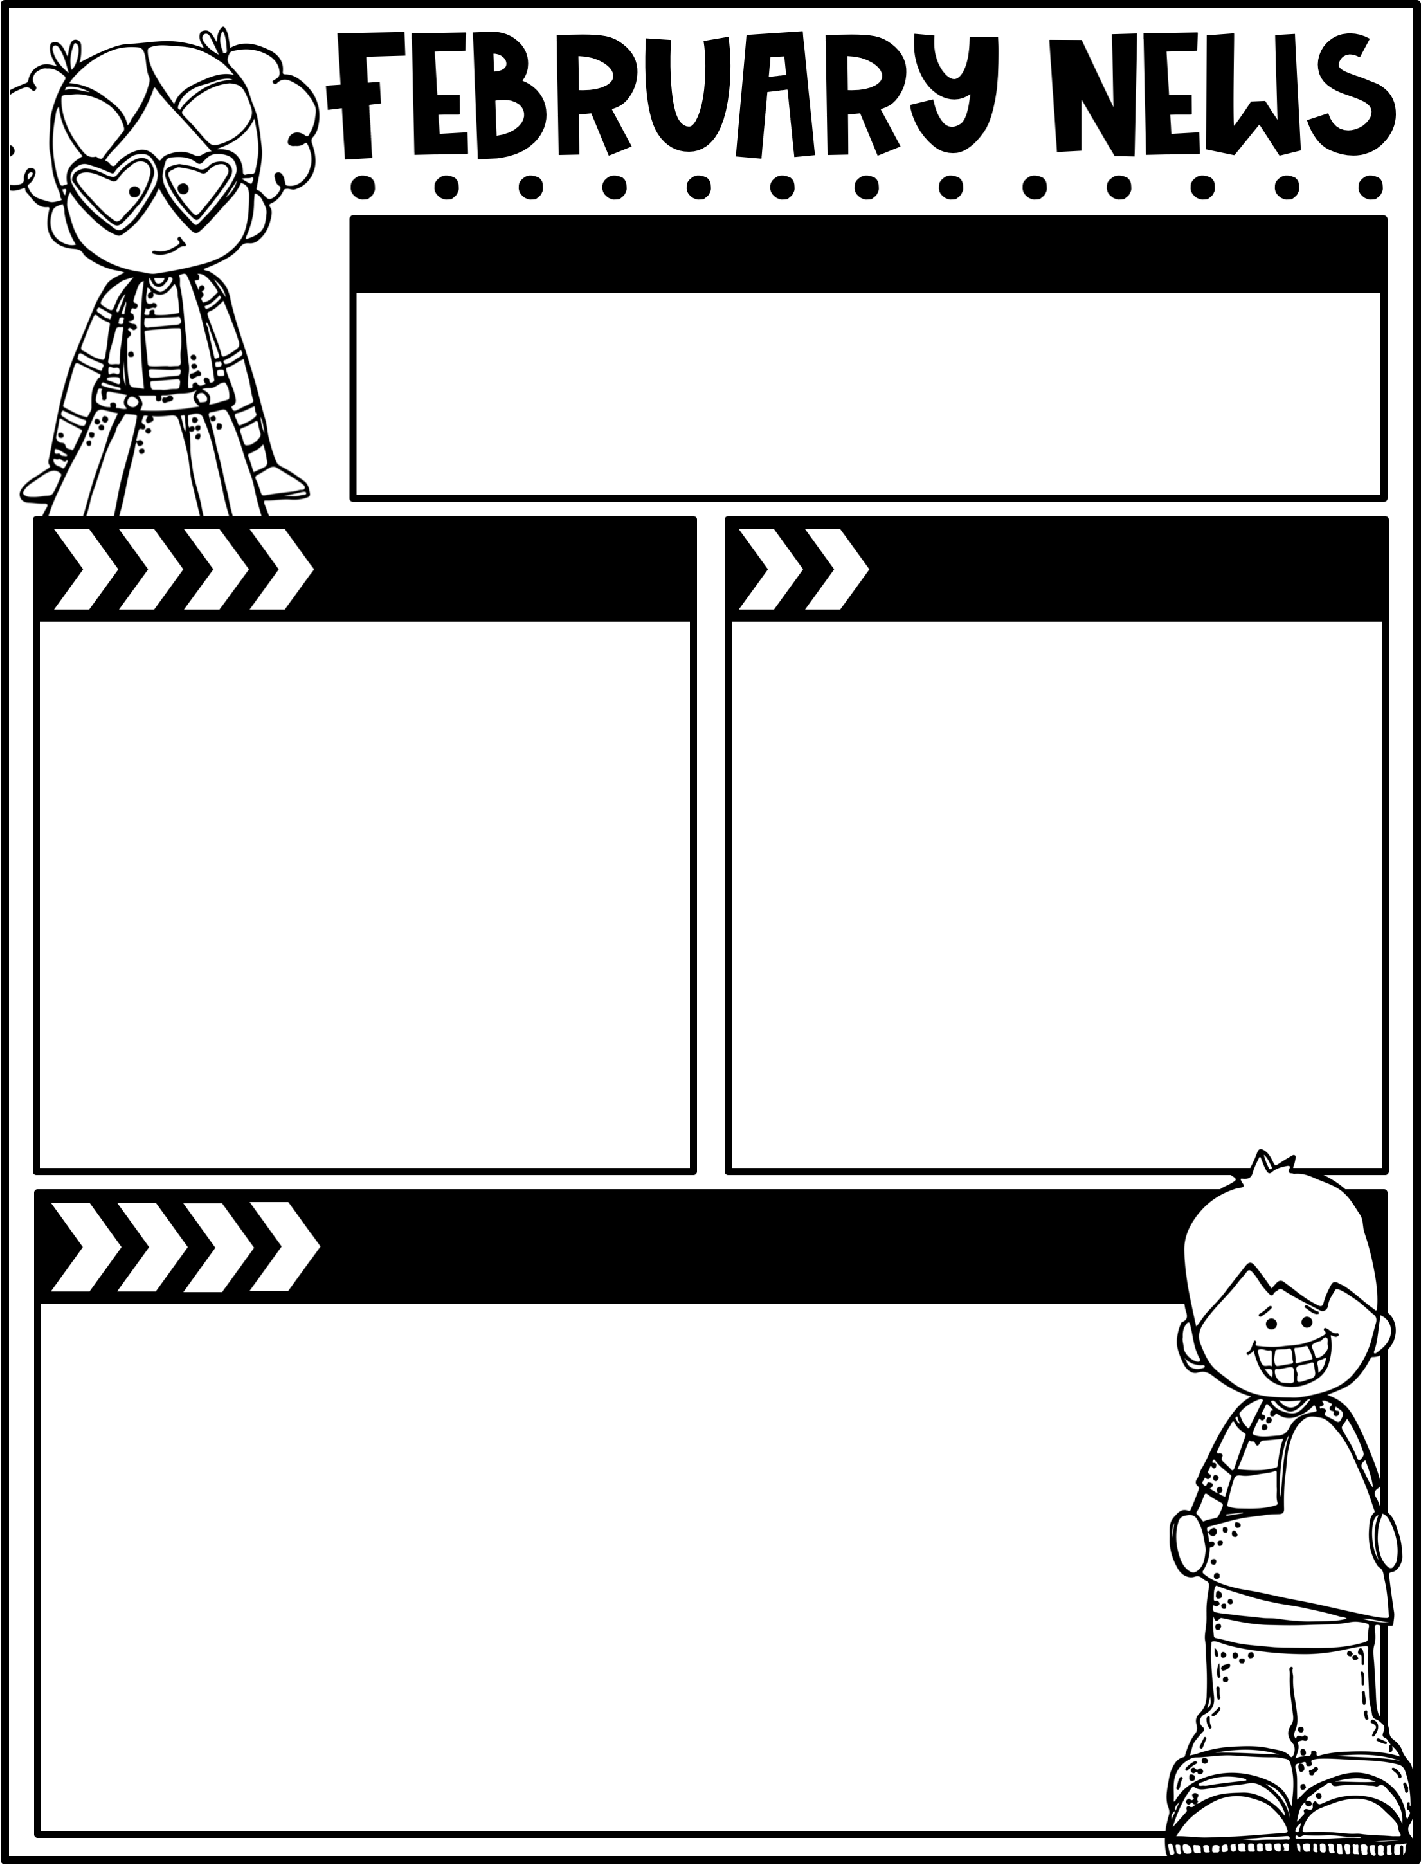
February 28, 2025
The Moreau Heights family is committed to providing a positive and safe learning environment to support responsible and productive citizens.
Phone:
573-659-3180
Plan Time:
1:35-2:25 pm
Emails:
mason.johnson@jcschools.us
danielle.mcgeorge@jcschools.us
theresa.schell@jcschools.us
Calendar
Learning Targets
M 3/03 B Day
TU 3/04 C Day
W 3/05 A Day
Th 3/06 B Day
F 3/07 C Day, Library Checkout
3/24-3/28 Spring Break, No School
Reading/Writing
I can decode 2 syllable words with CVC and open vowel patterns.
I can spell words featuring /ee/.
I can decode words with the suffix “tion”.
I can capitalize the first letters of holidays & geographic names.
Math
I can use place value drawings to represent addition & relate them to written recordings.
I can use efficient solution strategies for addition.
I can add up to four two-digit numbers.
I can fluently add within 20.
I can take from a ten or hundred to subtract.
Social Studies
I can discuss the difference between goods and services.
Things to Know
Specials Schedule:
Library Check-Out:
Second grade has check-out on Fridays! Please help your child remember their books!
SECOND STEP LESSON 19:
Problem Solving
Summary
In this week’s lesson, your child
will be able to generate ways to
make amends to solve a problem.
Try This at Home
Ask your child for examples of which
solutions are better than others for
a problem.
 | Mr. J | Mrs. M | Ms. S
A | Music | PE | Art
B | PE | Art | Music
C | Art | Music | PE

